Slide 1


MSBA FINANCIAL GROUP

Slide 2
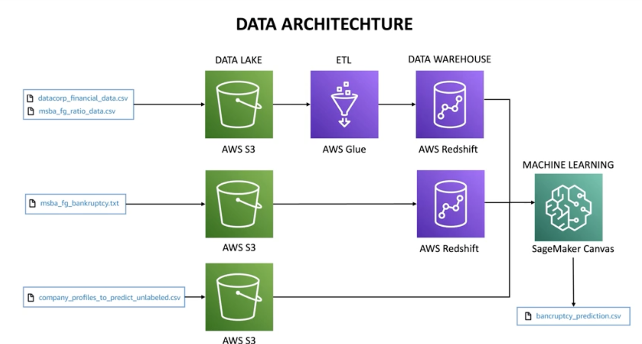

Slide 3
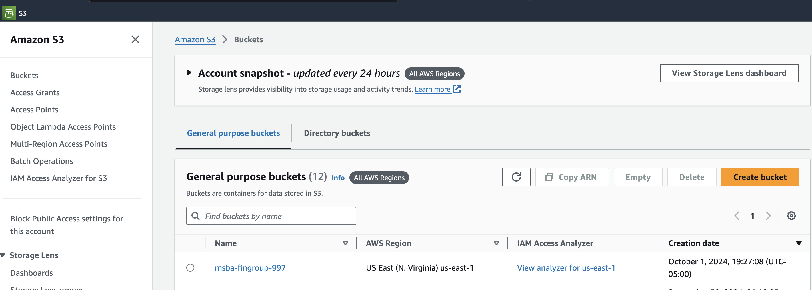

Slide 4
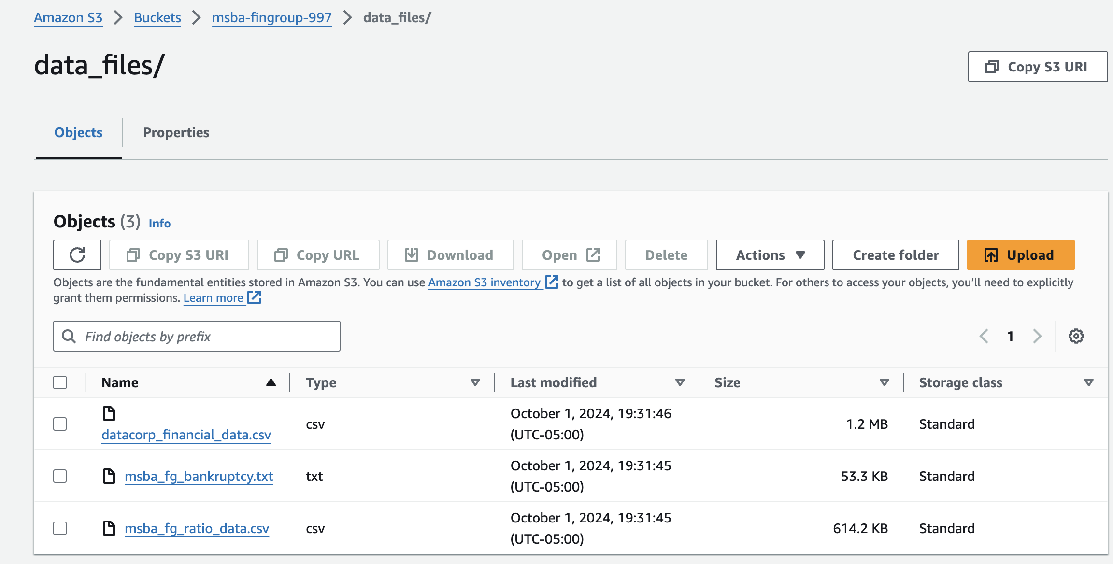
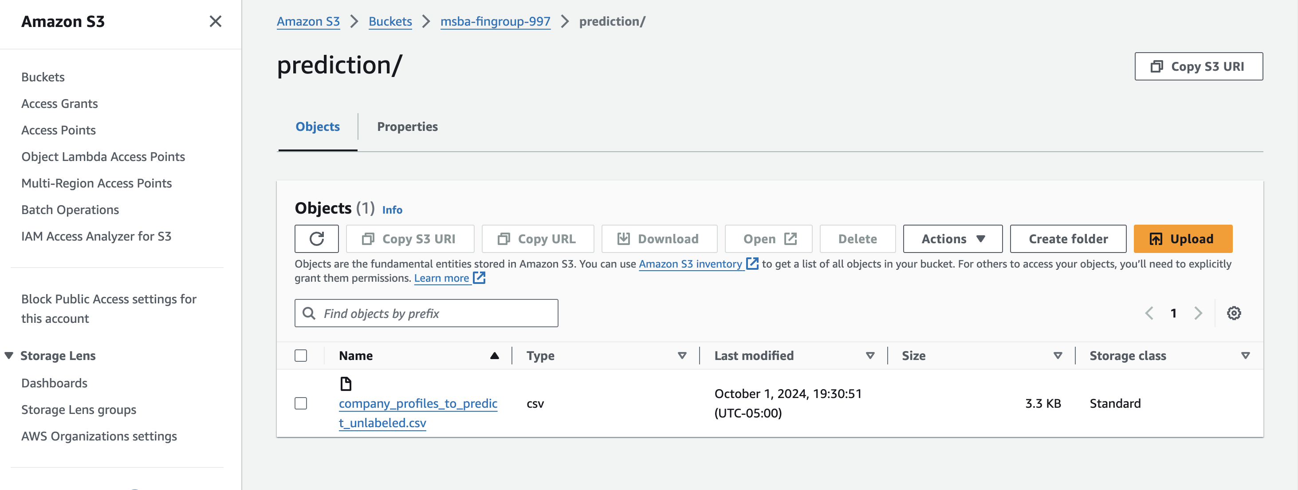

Slide 5
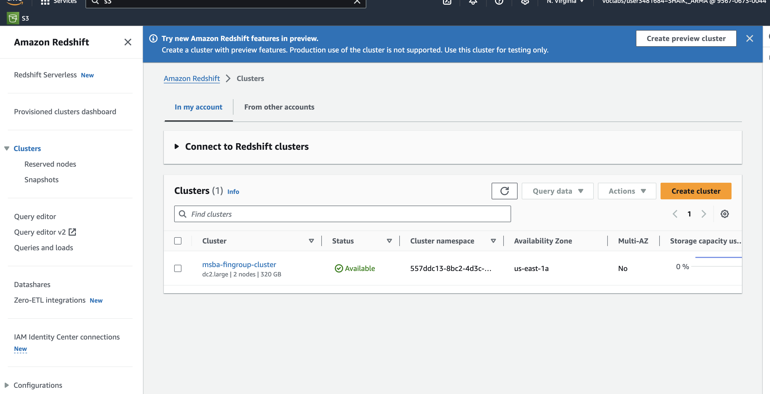
AMAZON REDSHIFT

Slide 6
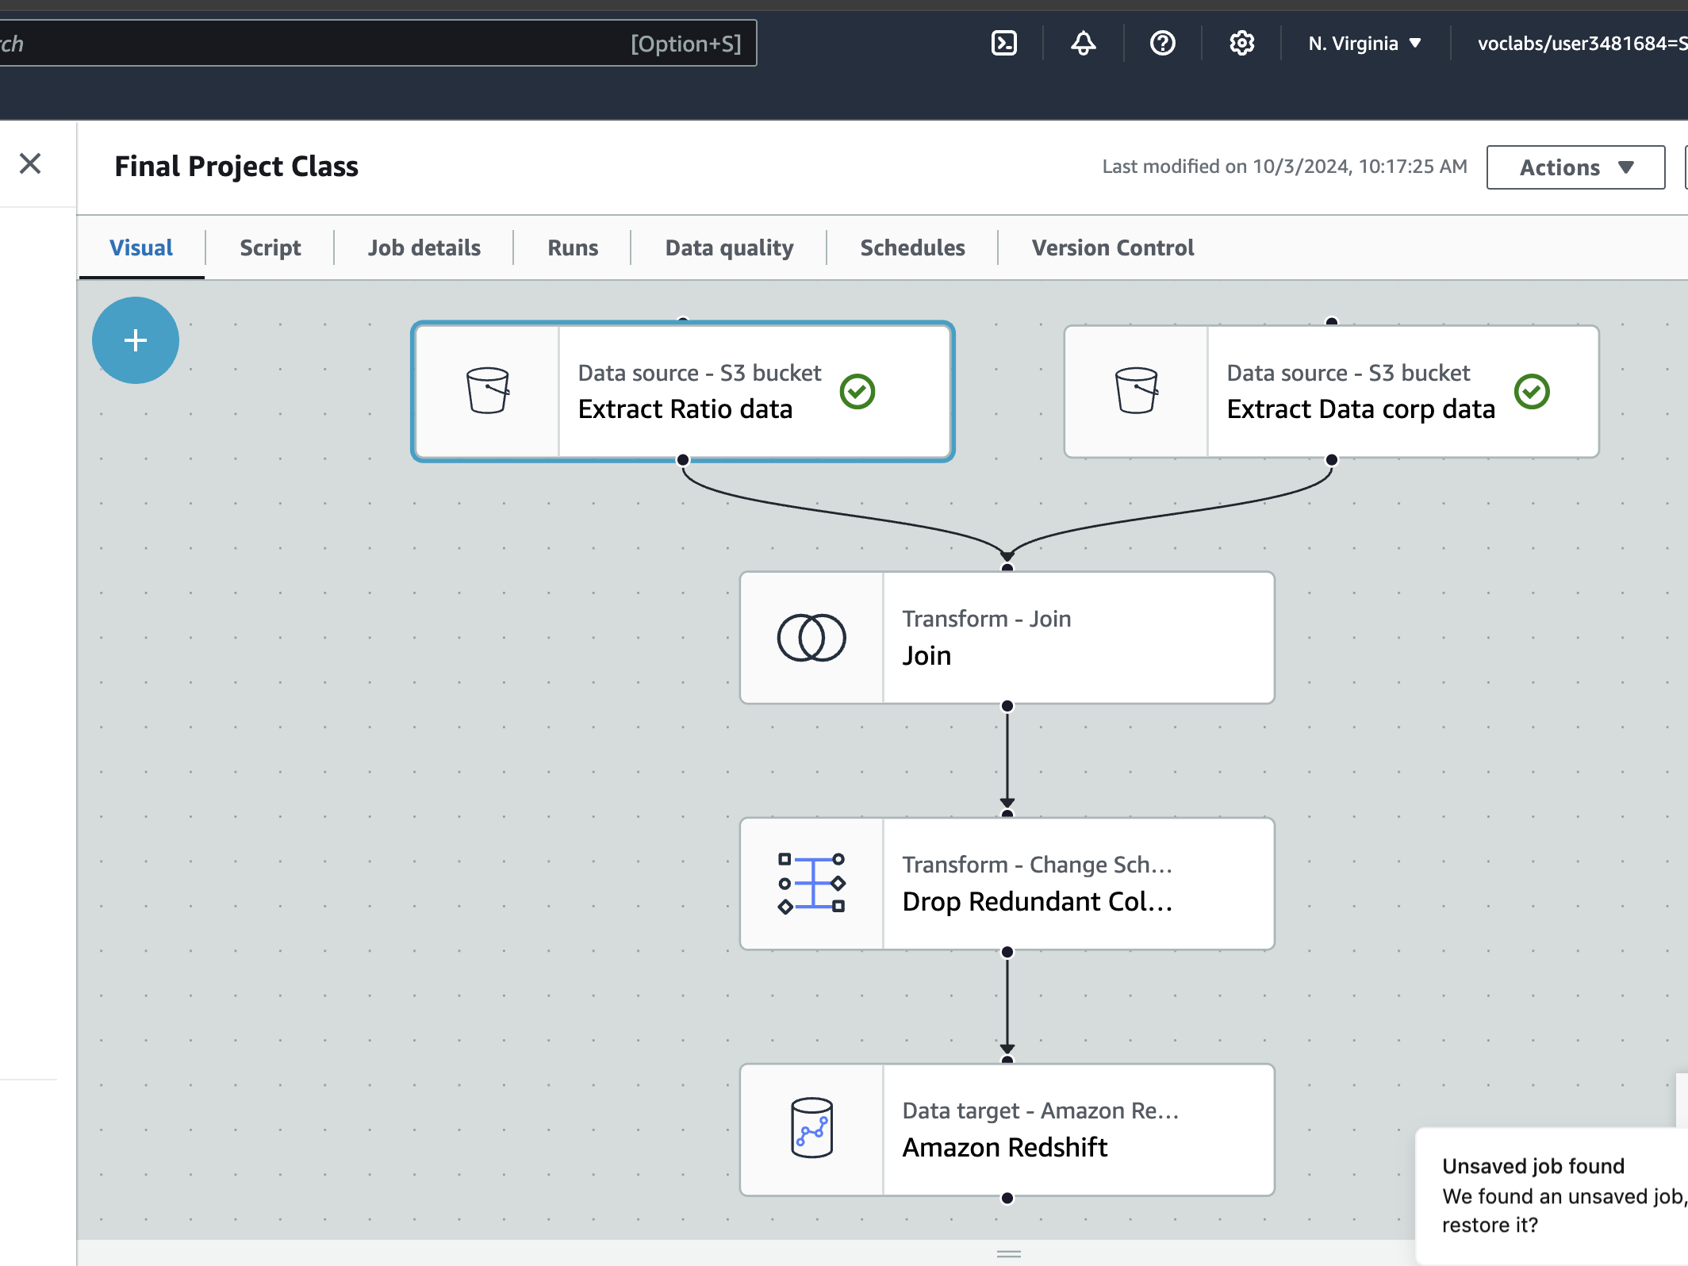
AWS GLUE FOR ETL

Slide 7
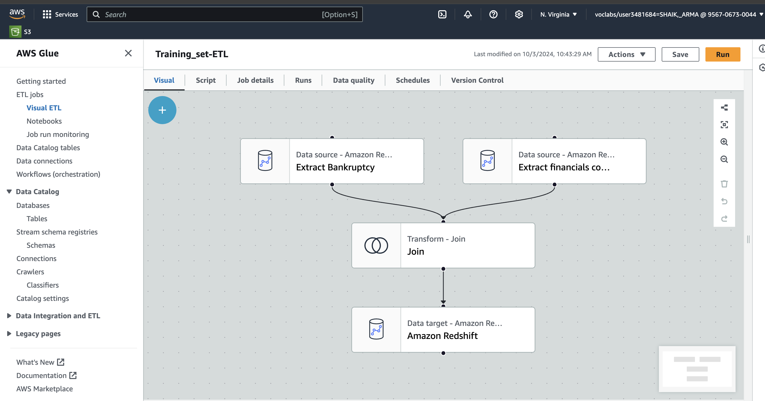
VISUAL ETL for attaching the Bankrupt and the financials combined data

Slide 8
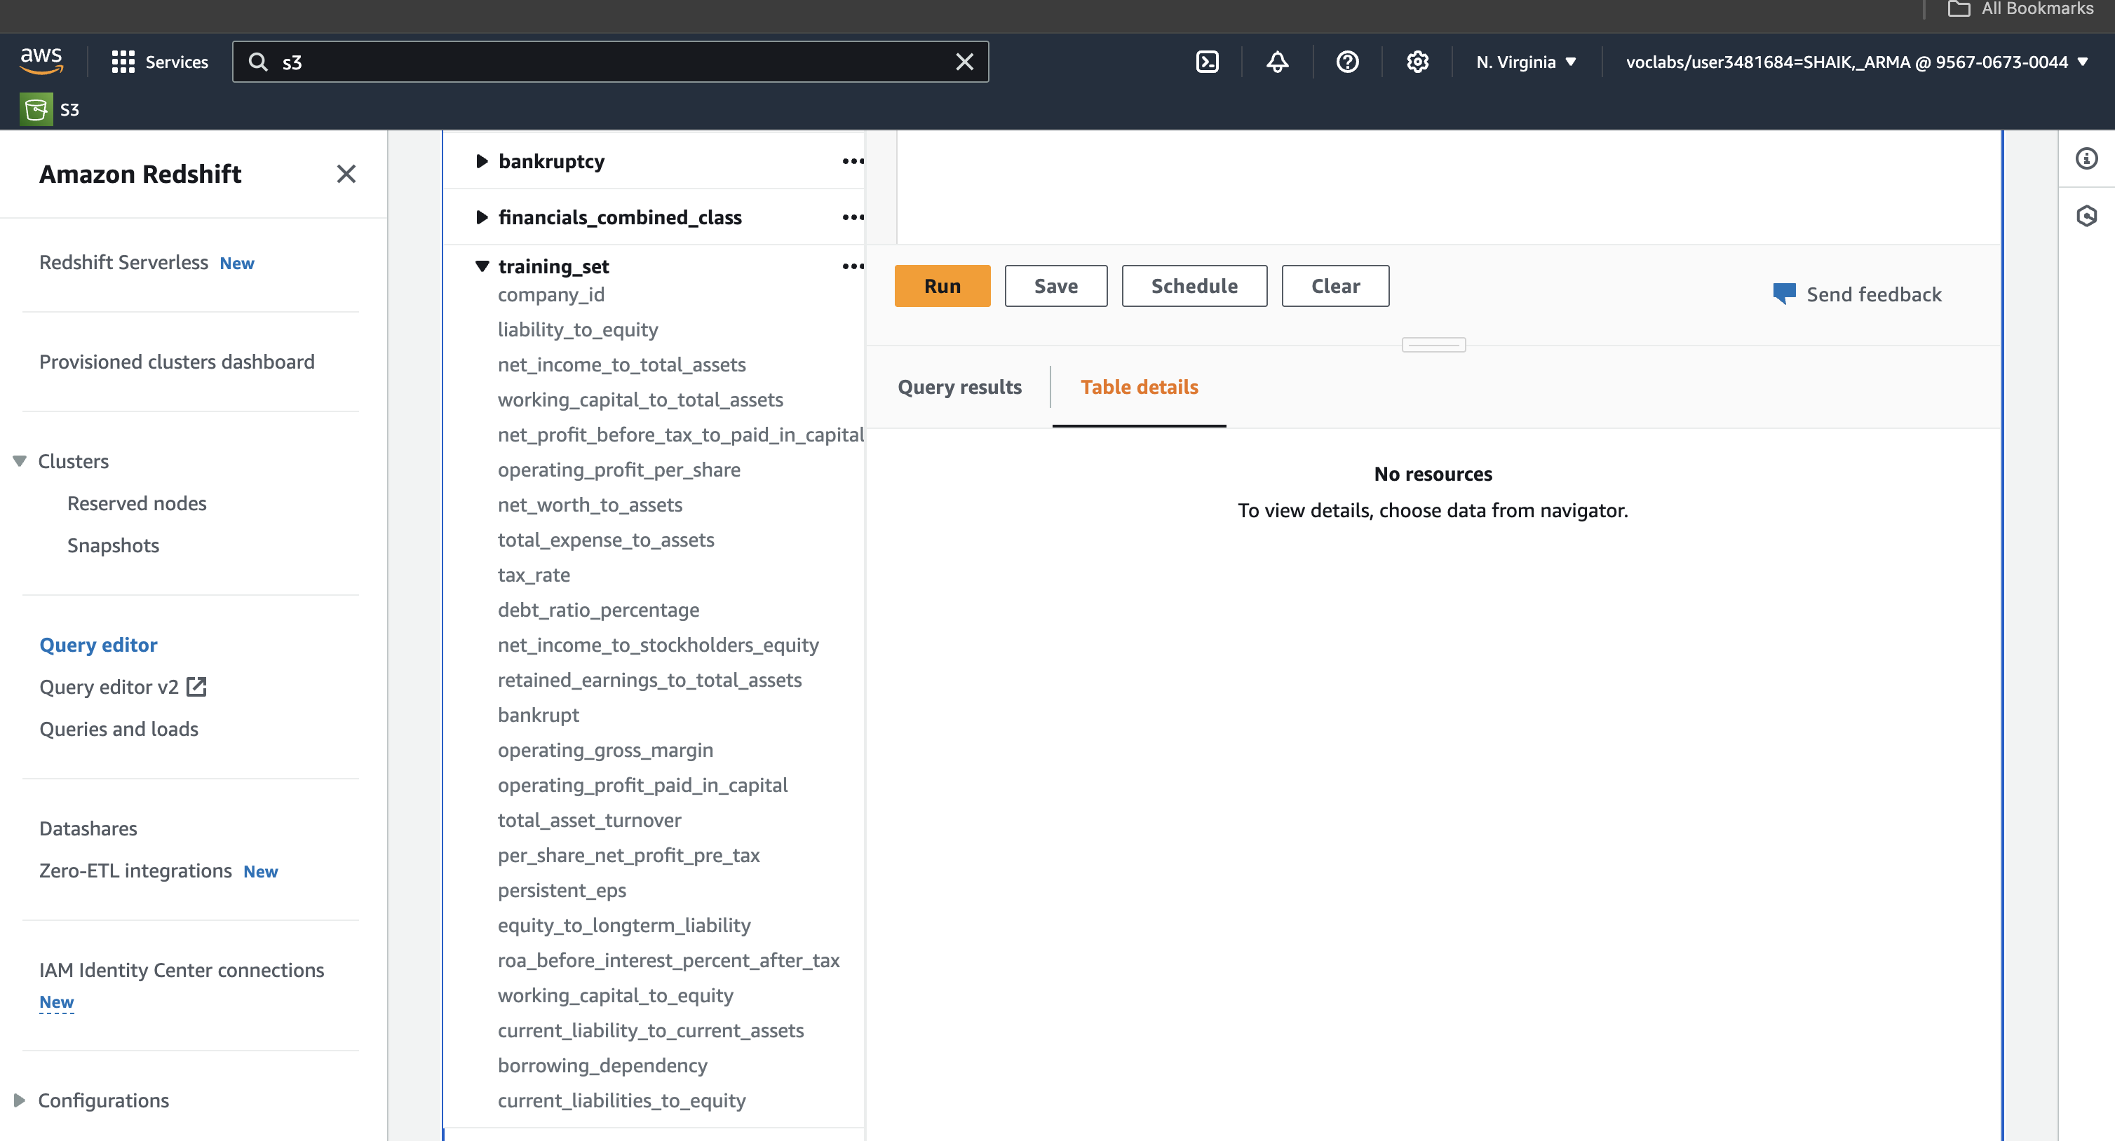
Combining financials_combined and Bankruptcy tables and loading to Redshift Cluster for training data

Slide 9
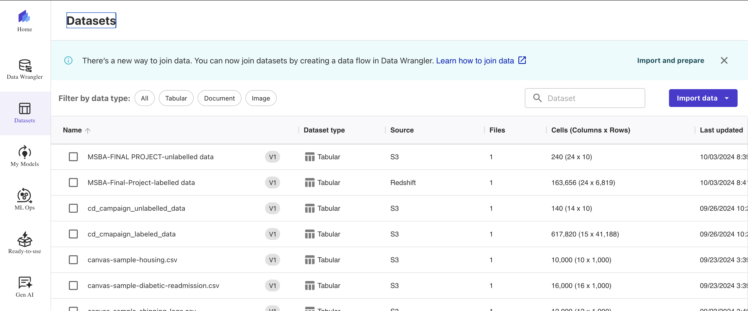
AMAZON SAGE MAKER
Importing data from Redshift cluster(training data) and S3 bucket (unlabelleddata data) into Amazon sagemaker.

Slide 10
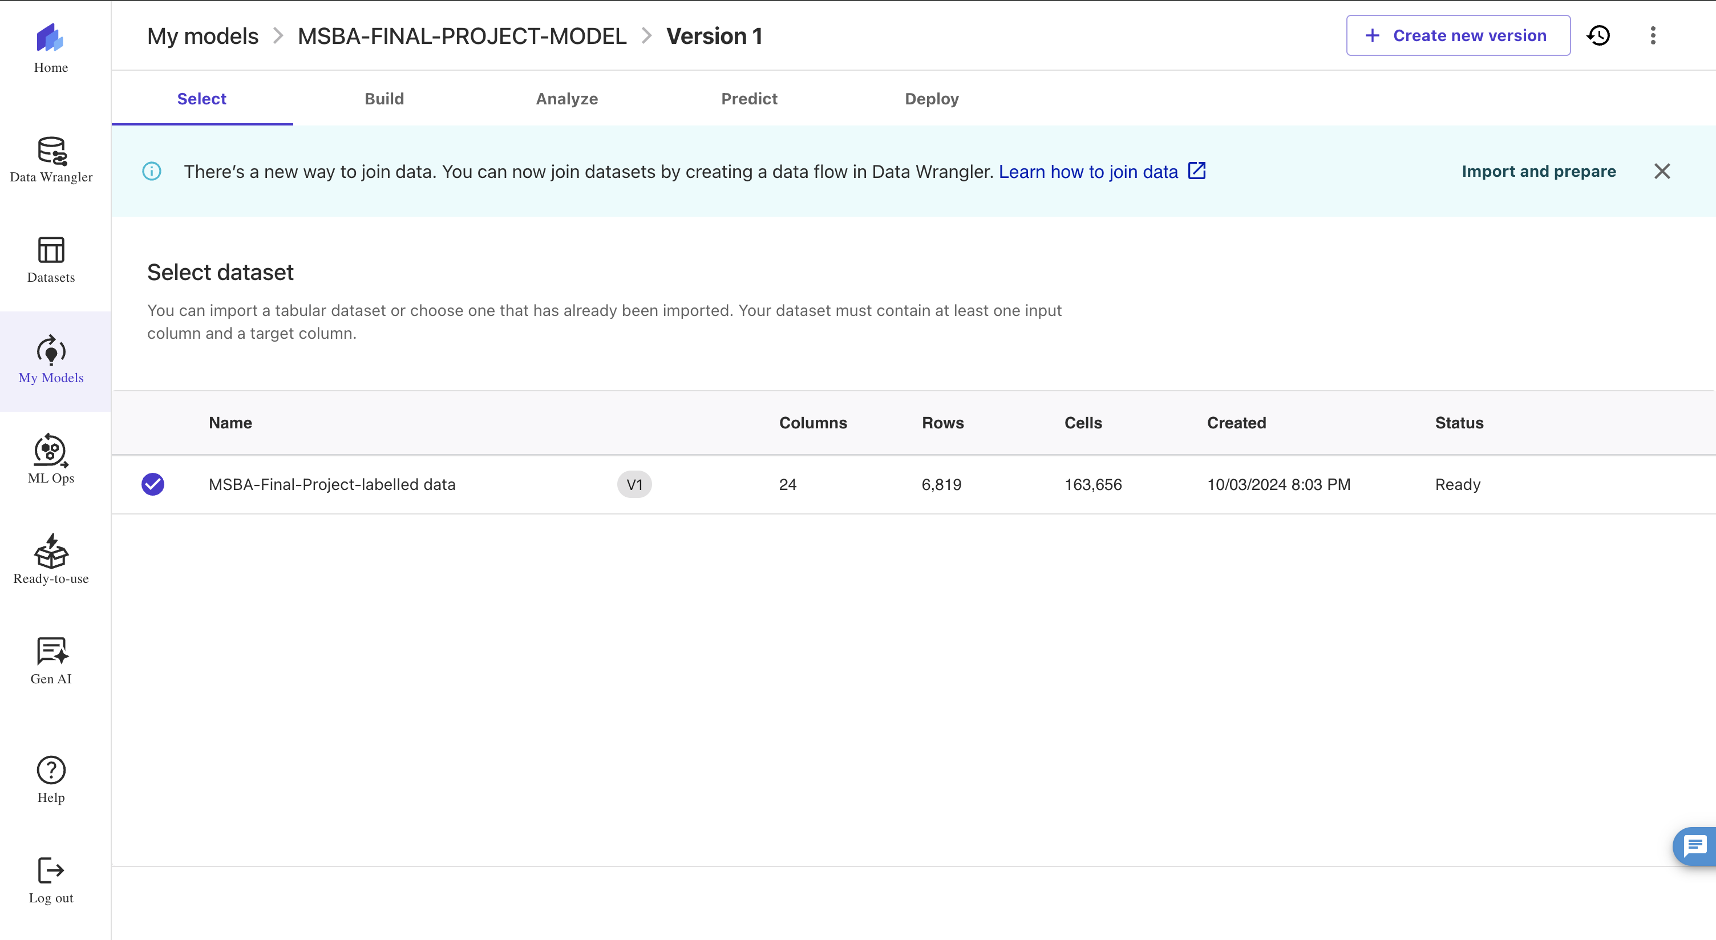
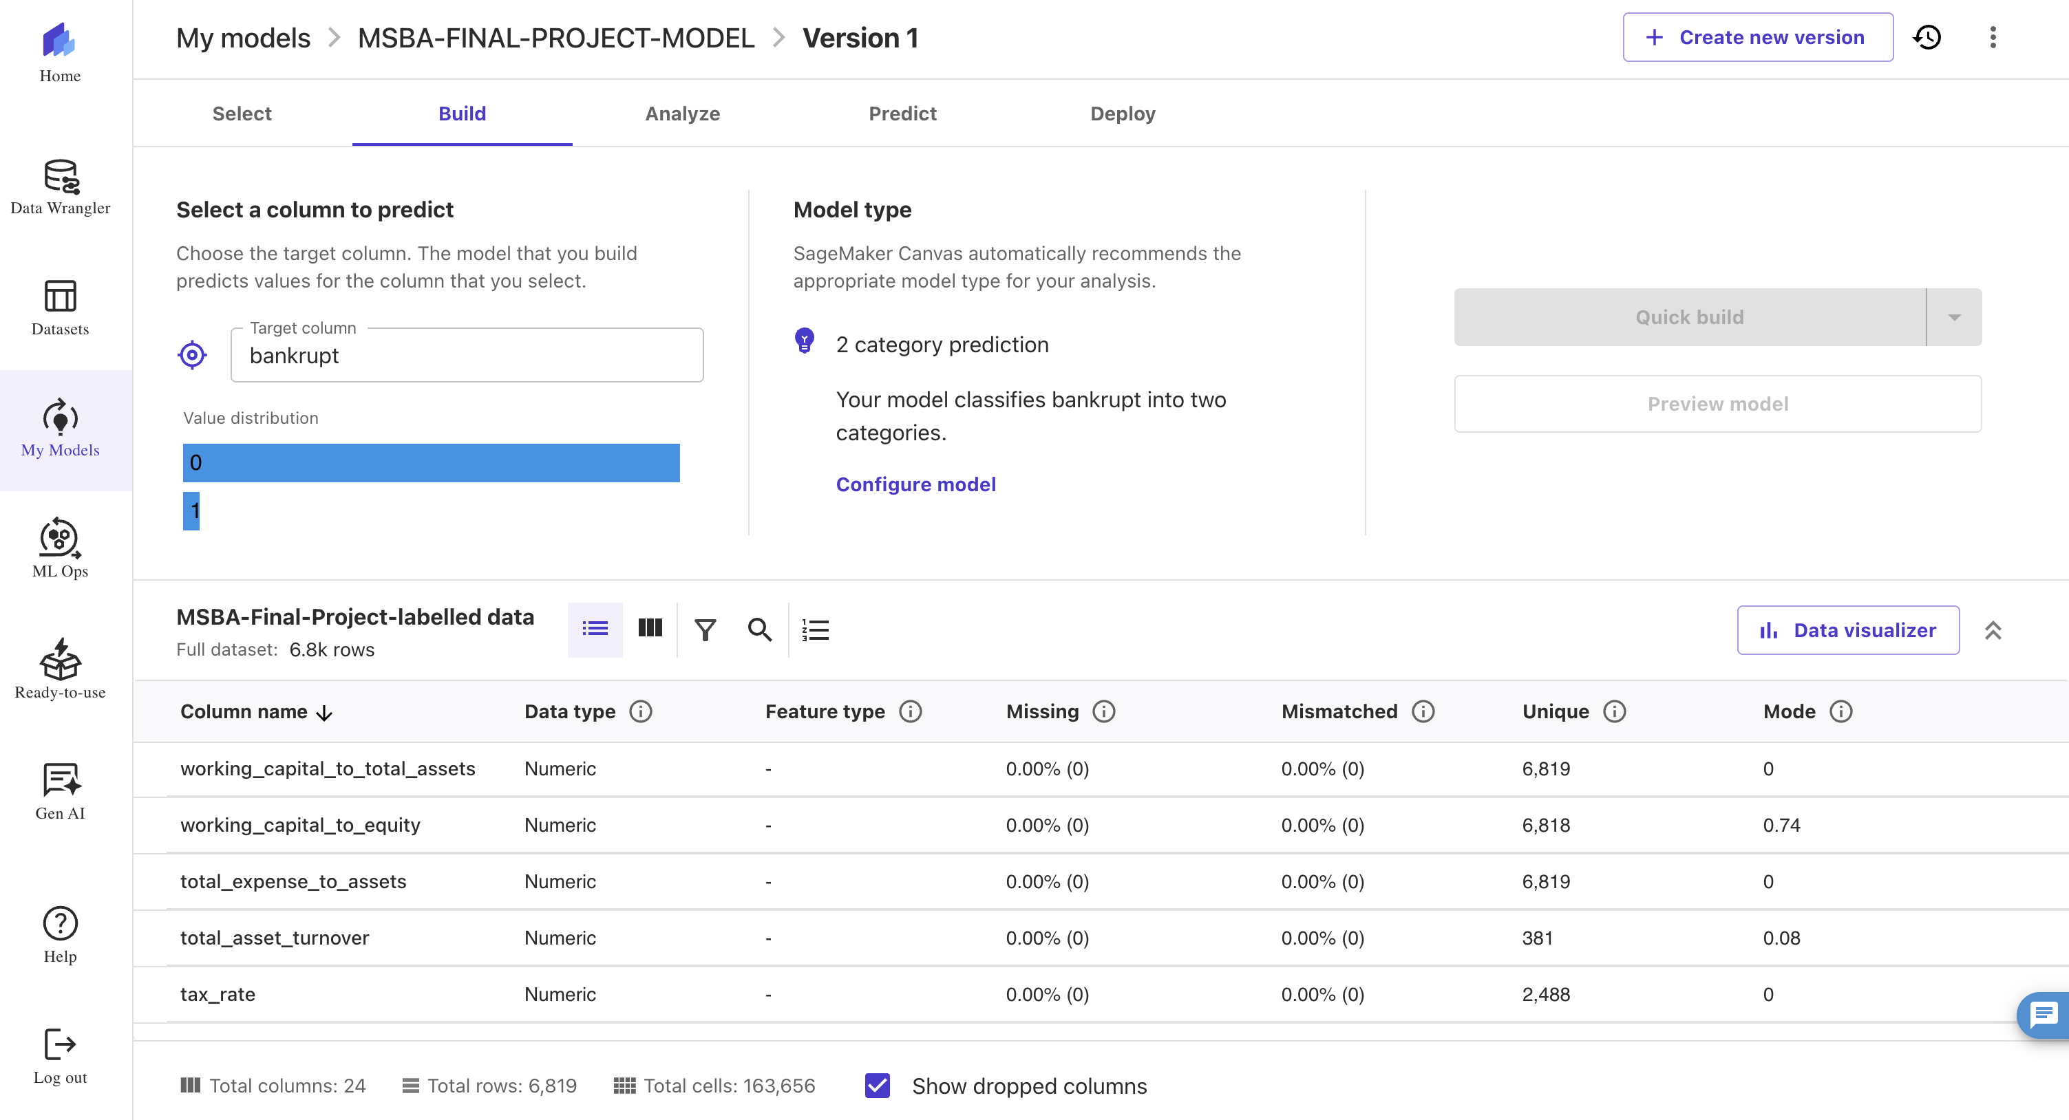
Building Machine Learning Model

Slide 11
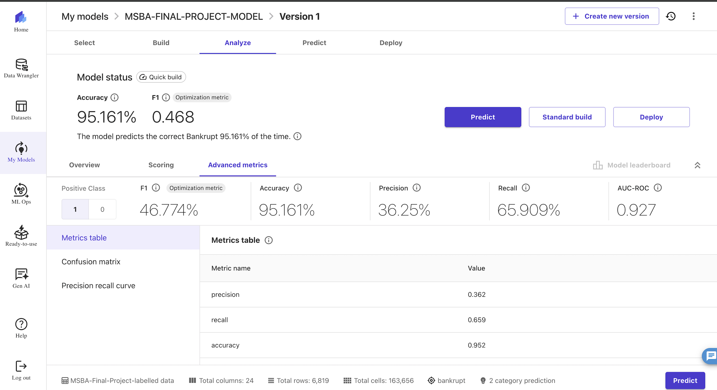
MODEL PREDICTIONS

Slide 12
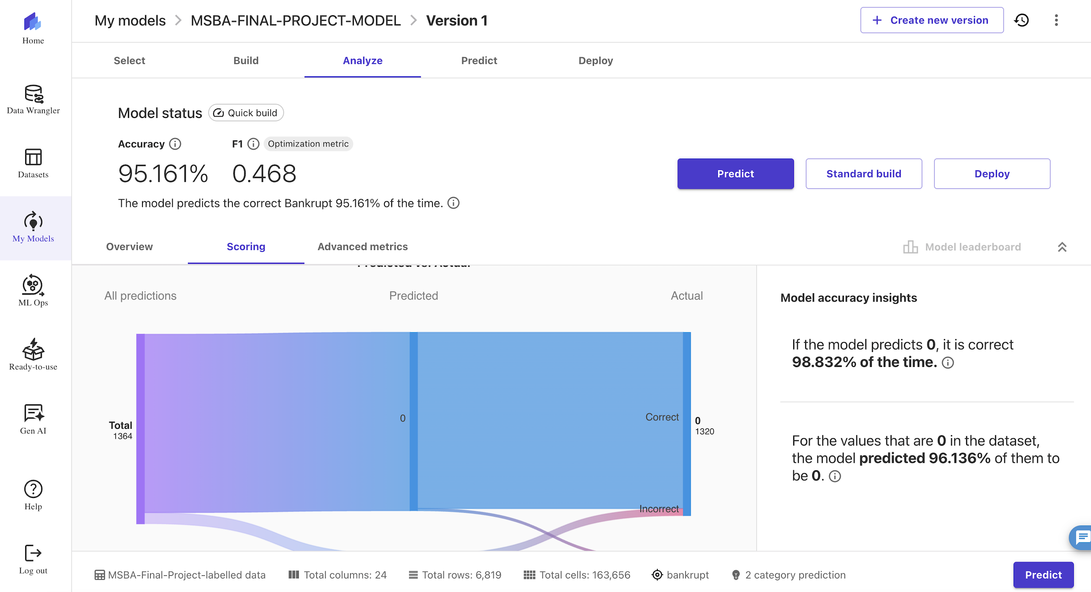
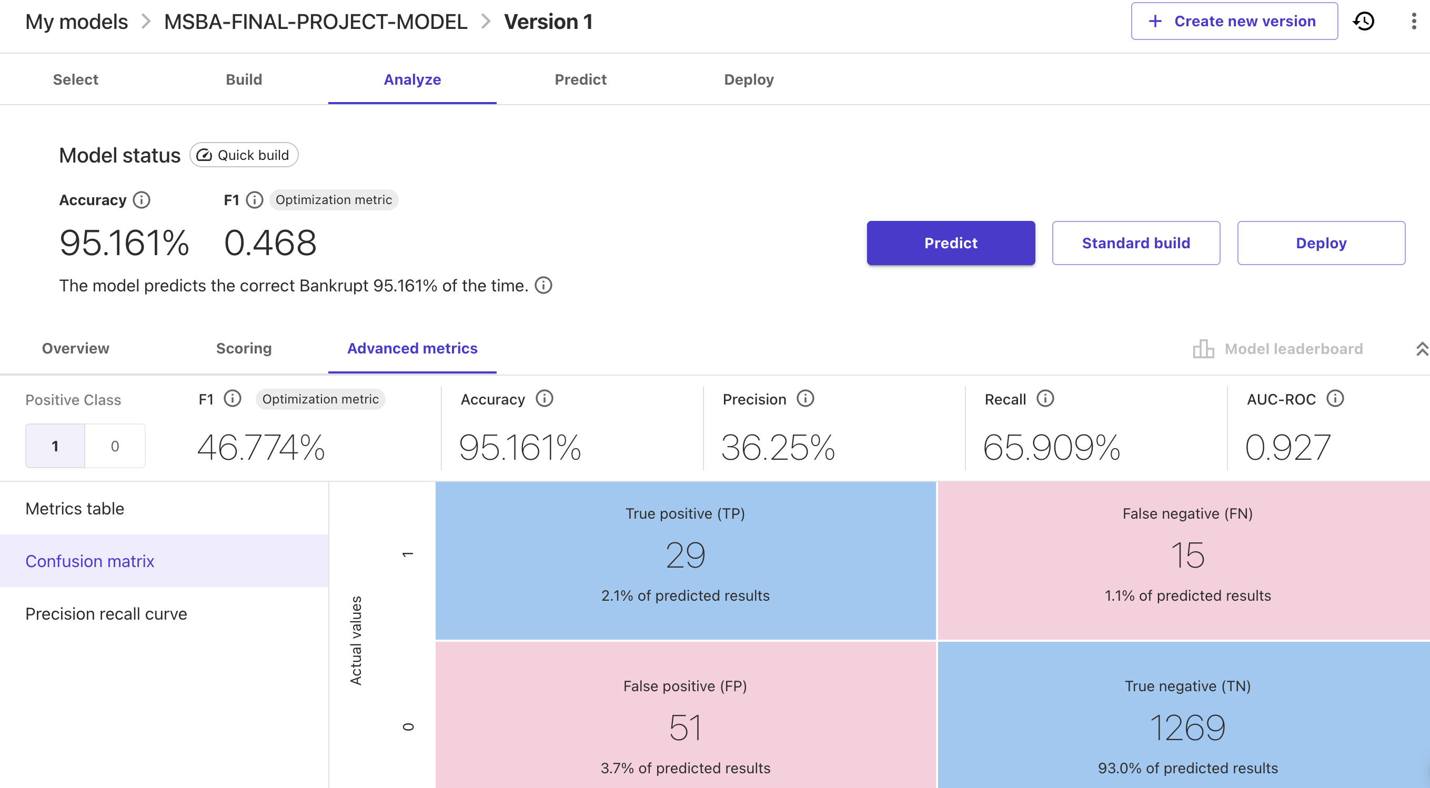
MODEL PREDICTIONS

Slide 13
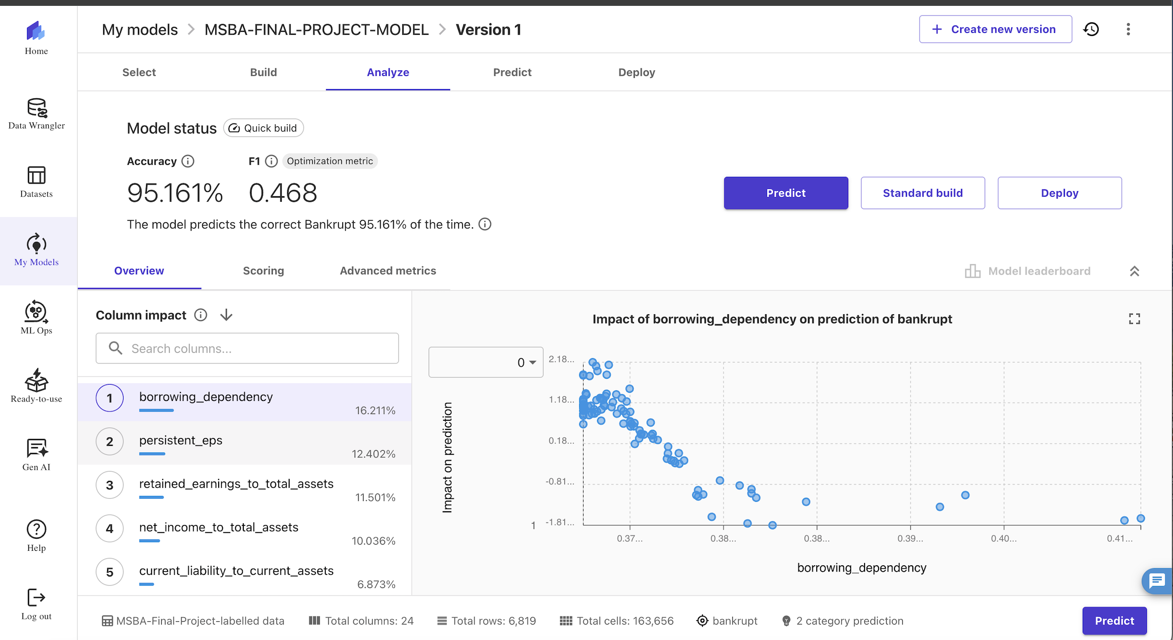
Exploratory Data Analysis(Finding 1)

Slide 14
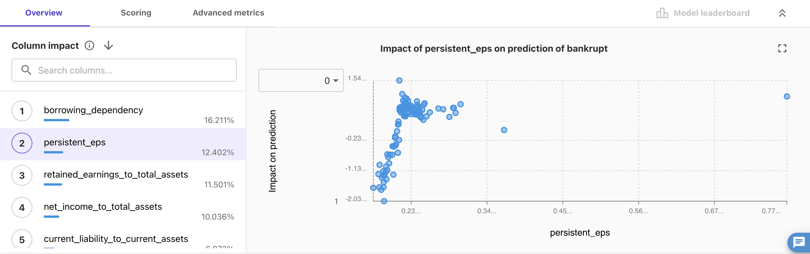
EXPLORATORY DATA ANALYSIS (FINDING 2)

Slide 15
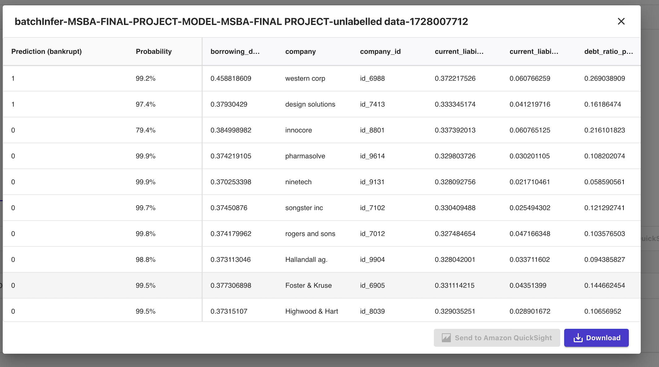
Predictions of our model for the un-labelled data

Slide 16
TOP 5 PREDICTORS FOR COMPANY GOING BANKRUPT
bankrupt | probability | company | company_id | borrowing_dependency | persistent_eps | Retained_earnings_to_total_assets | net_income_to_total_assets | current_liability_to_current_assets
1 | 0.99288565 | western corp | id_6988 | 0.458818609 | 0.15429706 | 0.879444615 | 0.64180449 | 0.060766259
1 | 0.97423822 | design solutions | id_7413 | 0.37930429 | 0.217736598 | 0.933467259 | 0.800780431 | 0.041219716
0 | 0.7941519 | innocore | id_8801 | 0.384998982 | 0.161482462 | 0.911441408 | 0.736619098 | 0.060765125
0 | 0.99912834 | pharmasolve | id_9614 | 0.374219105 | 0.225205635 | 0.935449309 | 0.815350392 | 0.030201105
0 | 0.9995966 | ninetech | id_9131 | 0.370253398 | 0.218398412 | 0.935200209 | 0.80364729 | 0.021710461
0 | 0.99780607 | songster inc | id_7102 | 0.37450876 | 0.217831143 | 0.938289897 | 0.804194657 | 0.025494302
0 | 0.99848729 | rogers and sons | id_7012 | 0.374179962 | 0.21896568 | 0.942828956 | 0.814110614 | 0.047166348
0 | 0.98857784 | Hallandall ag. | id_9904 | 0.373113046 | 0.20468942 | 0.932955215 | 0.804886953 | 0.033711602
0 | 0.99519491 | Foster & Kruse | id_6905 | 0.377306898 | 0.219343859 | 0.930139635 | 0.803260161 | 0.04351399
0 | 0.9956789 | Highwood & Hart | id_8039 | 0.37315107 | 0.212914815 | 0.930763203 | 0.794157853 | 0.028901672

Slide 17
RECOMMENDATIONS BASED ON THE PREDICTIONS
I would suggest investing in the companies Pharmasolve , Nine-Tech, and Rodgers and Sons as all three show a very high probability of the companies not being bankrupt.
Additionally, as per the top 5 attributes specified in the previous slide suggests that these companies have a lower borrowing dependency and high persistent earning per share when compared to the other companies.

Slide 18
CONCLUSIONS
As per the model predictions, the following companies are at the highest probability of going bankrupt.
-> Western Corp
-> Design Solutions
The companies Pharmasolve , Nine-Tech, and Rodgers and Sons are safe to invest in, as the model predicts a high chance for not going bankrupt.

